Slide 1
Performance
Advanced Android Development
Lesson 4

Slide 2

4.0 Performance
Introduction and methodology

Slide 3
Contents
What is good performance?
16 milliseconds per frame
Basic performance test
Checking frame rate
Tackling performance problems
Keeping your app responsive

Slide 4
What is good performance?

Slide 5
What is bad performance?
App does not load or app takes a long time to load
Animations stutter
App crashes randomly
Battery drains fast
Uses lots and lots of data-plan data
Slow or inconsistent response to user actions

Slide 6
What is good performance?
App loads fast
Animations are smooth
No crashes
App respects device's limited battery resources
Optimizes internet data transmission
Consistent and fast response to user actions

Slide 7
Users up-rate apps that perform well
… and they uninstall and down-rate apps that don't
To stand out from the crowd, create apps that
Have a small APK, run fast & smooth, use resources efficiently
Optimize use of memory, device storage, and battery
Are considerate of data plan when transferring data on internet

Slide 8
16 milliseconds per frame

Slide 9

Refresh rate and 16 milliseconds
Still images in sequence create illusion of motion
Flip book: 10-12 pages/second
Movies: 24-30 frames/second
High-quality: 60 frames/second
"Frame rate," "frames per second," "FPS"

Slide 10
60 FPS = 16.6 milliseconds per frame
Most modern device hardware refreshes display at 60 FPS
1000 ms / 60 frames = 16.666 ms/frame
Software and system must match that rate...
… and draw one complete frame per 16.6 ms
Your app does not get all of that time! Android system needs some, too!

Slide 11
Frame rate
Frame rate (FPS) is the frequency (rate) at which consecutive images (frames) are displayed.
Mobile devices typically display 60 FPS
60 FPS appears as smooth motion to human eye

Slide 12
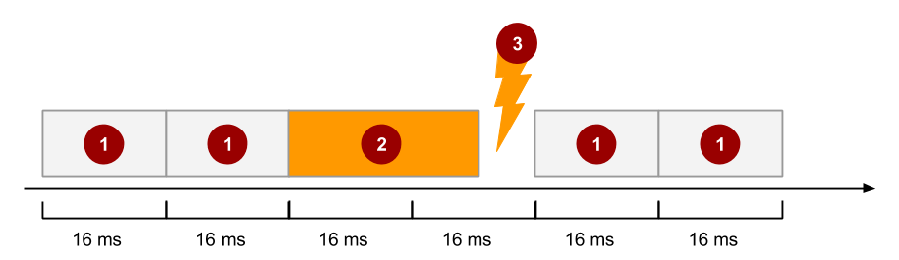
Dropped frames
If your app does not finish updating in 16 ms, frame is dropped
Users see stutter

Slide 13
Basic performance test

Slide 14
Most basic performance test
User perception
Performance on low-end devices
Slow-downs over time
Responsiveness
Crash robustness

Slide 15
Steps for basic performance test
Install on lowest-end physical target device
Use thoroughly and take detailed notes
Try to crash the app. Try hard!
Ask a friend to test it
Run mini-usability test—watch Usability Cafe video

Slide 16
Physical device versus emulator
Performance data in emulator is less accurate
Might be hard to test with low-bandwidth and unreliable networks on physical device
Simulate using emulator and adjusting its settings
See Extended controls, settings, and help and Start the Emulator from the Command Line—look for the netdelay parameter

Slide 17
Checking
frame rate

Slide 18
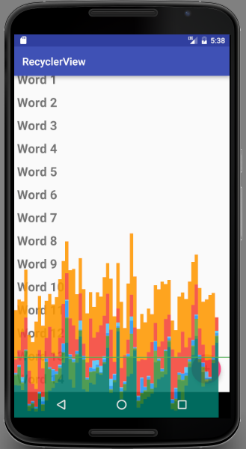
Profile GPU Rendering
Profile GPU Rendering tool visualizes how long it takes an app to draw frames
Important: Requires at least Android 4.1 (API level 16)

Slide 19
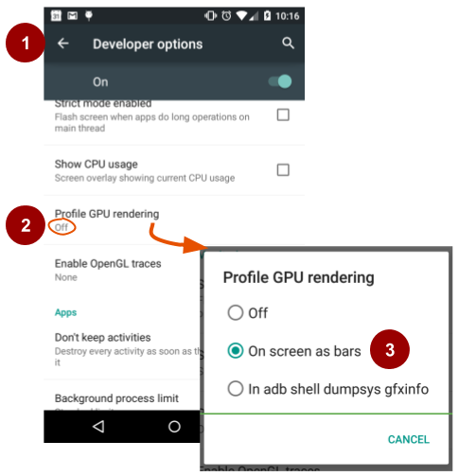
Starting Profile GPU Rendering
Settings > Developer options
Scroll to Monitoring section and select Profile GPU rendering
Choose On screen as bars

Slide 20
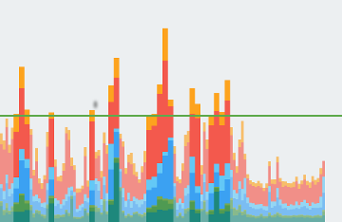
Profile GPU Rendering on device
1 vertical bar == 1 frame
Colors == rendering stages
Horizontal green line == 16 ms/frame
If bar extends above line, the bar is wide and > 16 ms/frame
If bar is below line, the bar is narrow and dim and < 16ms/frame

Slide 21
What it's good for
Green horizontal line: See how frames perform against target of 16 ms/frame
Bars: Identify whether the time taken by any part of the rendering pipeline stands out
Look for spikes in frame-rendering time associated with user actions or program actions

Slide 22
Tackling performance problems

Slide 23
Use performance profiling tools
On device:
Profile GPU Rendering tool
Debug GPU Overdraw tool
… and many more

Slide 24
Use performance profiling tools
In Android Studio:
Layout Inspector
Android Profiler
Systrace and dumpsys
Batterystats and Battery Historian
…. and many more

Slide 25
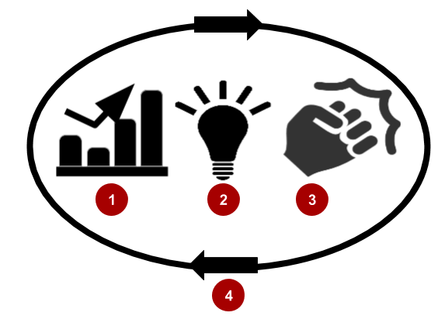
Performance Improvement Lifecycle
Gather information using tools
Analyze data to gain insight
Take action and fix problems
Verify and iterate

Slide 26

Gather information using tools
Use tools to gather data
Lots and diverse data
Multiple devices and usage patterns
Be thorough
Keep records to track improvements

Slide 27

2. Analyze to gain insight
Take time to understand data in context of your app
There may be more than one problem
Obvious problem may cover up deeper problems

Slide 28

3. Take action and fix problems
Evaluate more than one way to solve problems
Consider constraints and trade-offs
Resources, budgets, deadlines

Slide 29

4. Verify and iterate
Gather new data after changes to app
Compare to original data
Did you solve the (right) problem?
Do you need further improvements?

Slide 30
Keeping your app responsive

Slide 31
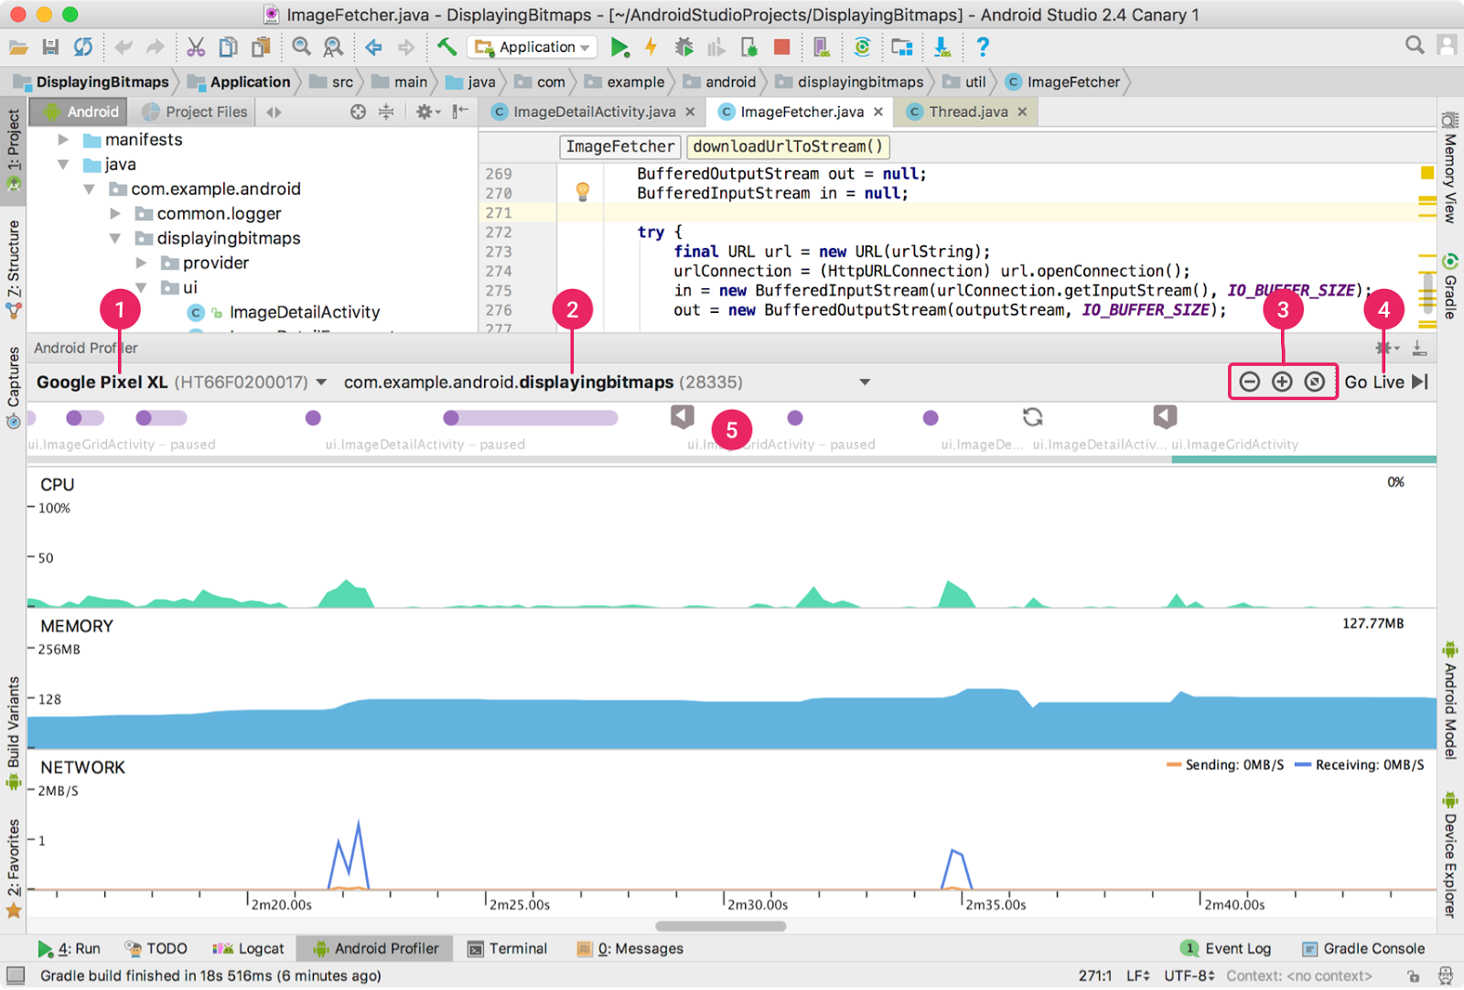
Monitor with Android Profiler tool
Monitor while developing
Real-time data from device
CPU, memory, network
Allocations, heap

Slide 32
What's next?
Concept chapter: 4.0 Performance
Practical: none

Slide 33
END

